Slide 1
Automated Attribution of Unknown Cryptocurrency Wallets to Nearest VASPs
Blockchain Intelligence + Transaction Graph Analysis + Evidence-Based Attribution
Genesis-Blockers | Smart India Hackathon
From an unknown blockchain address to an evidence-backed VASP attribution.
github.com/Genesis-Blockers/Genesis-Blockers

Slide 2

The Problem: Why Attribution Is Hard
1
2
PSEUDONYMITY
TRANSACTION COMPLEXITY
Blockchain addresses do not inherently reveal real-world ownership or VASP identity.
A single wallet can interact with a large and rapidly changing set of addresses.
3
4
INTERMEDIARY HOPS
DIRECT MATCHING IS INSUFFICIENT
Funds can move through multiple intermediate wallets before reaching a known service.
Address-to-label lookups cannot explain attribution when relevant relationships occur across multiple transaction hops.
RAW BLOCKCHAIN ACTIVITY ≠ ACTIONABLE ATTRIBUTION

Slide 3

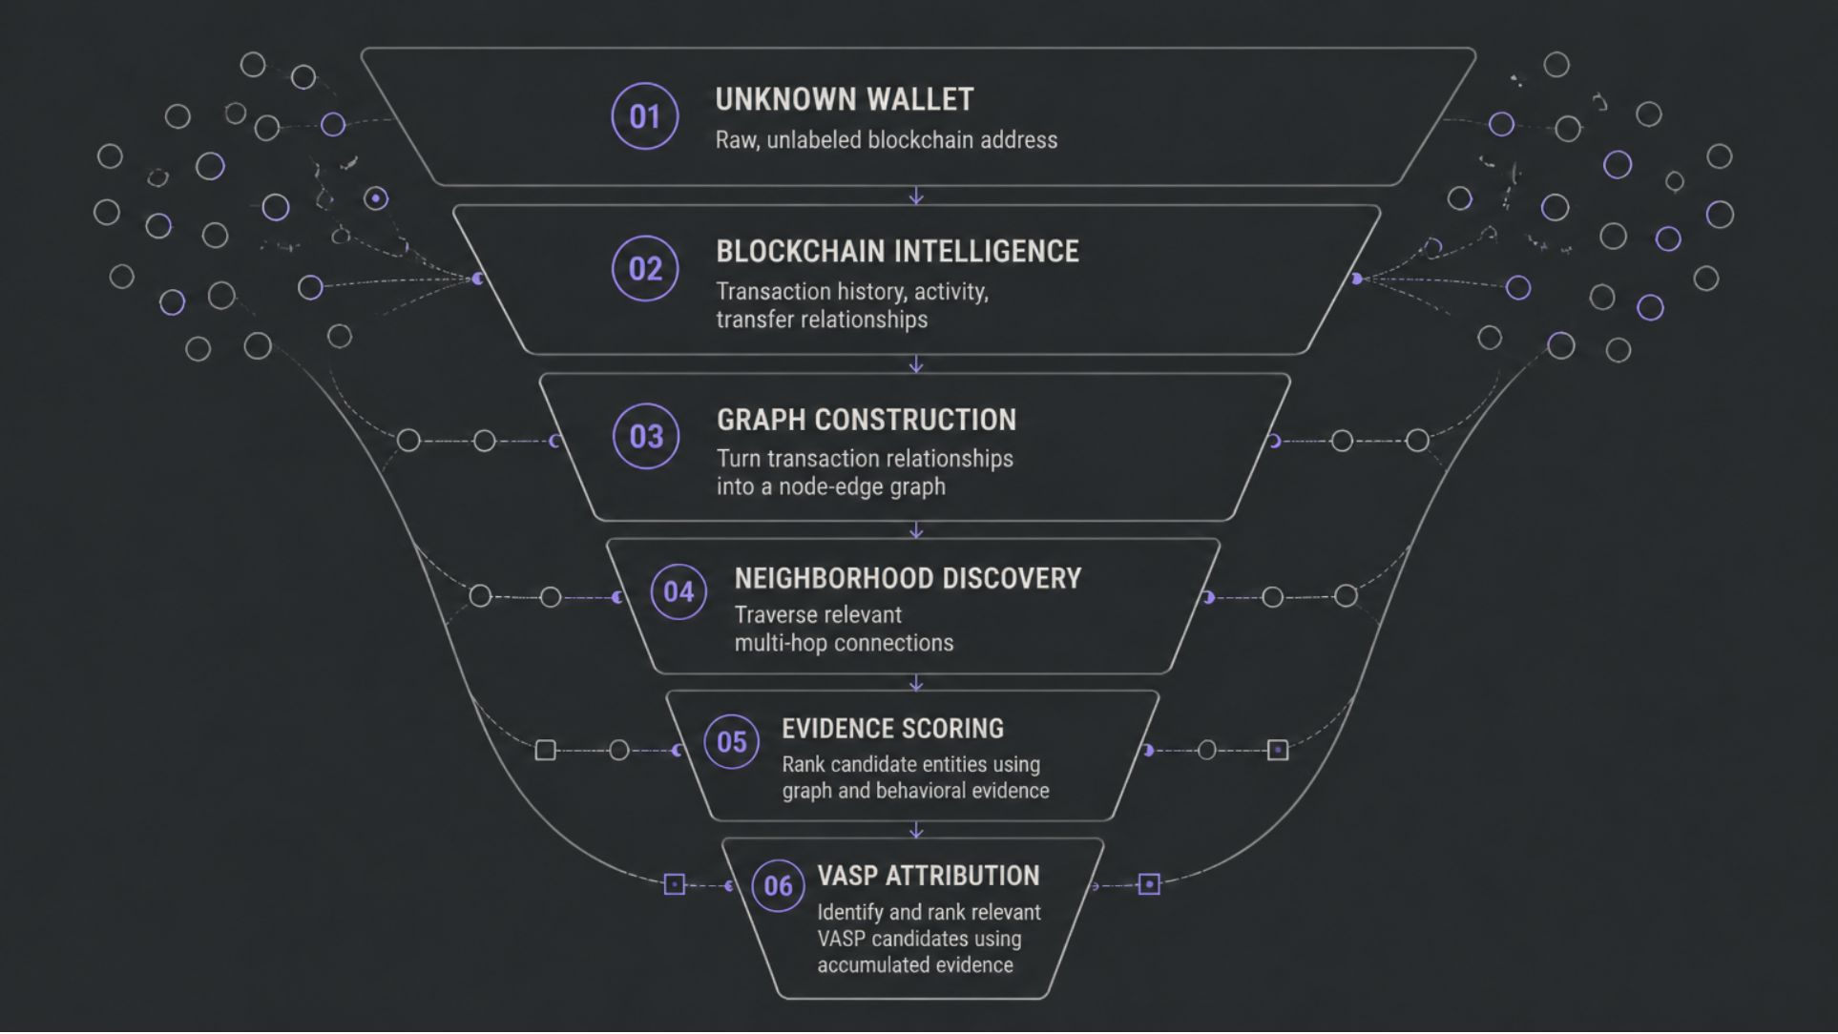
Our Core Idea: Progressive Filtering
Instead of searching the entire blockchain for a label, the system progressively narrows the search space using transaction, graph, and entity evidence.
We reduce a massive blockchain search space into a small set of relevant VASP candidates.

Slide 4
End-to-End System Architecture
1. USER
2. FRONTEND
User submits wallet address and analysis parameters
3. BACKEND / API ORCHESTRATION
4. DATA LAYER
Coordinates the analysis pipeline and service communication
BLOCKCHAIN SERVICE: Retrieves and normalizes relevant blockchain transaction intelligence
5. GRAPH INTELLIGENCE
6. ATTRIBUTION LAYER
GRAPH SERVICE: Converts transaction relationships into a traversable transaction graph
SCORING SERVICE: Evaluates and ranks candidate entities using accumulated evidence
7. VASP INTELLIGENCE
8. ATTRIBUTION RESULT
Provides known VASP/entity information for candidate identification and enrichment
Returns relevant VASP candidates with supporting evidence and confidence indicators

Slide 5

From Blockchain Transactions to a Transaction Graph
Which entities are connected to this wallet, how closely are they connected, and through what transaction paths?
Instead of looking at transactions independently, we model relationships between addresses as a graph.
UNKNOWN WALLET ——————————> WALLET A —————————>WALLET B —————————————————→KNOWN VASP
NODES:
EDGES:
Wallet addresses
Relevant blockchain entities
Known VASP/entity nodes
Transaction / transfer relationships
Edge attributes: sender, receiver, asset/value, timestamp, transaction ID, blockchain/network

Slide 6
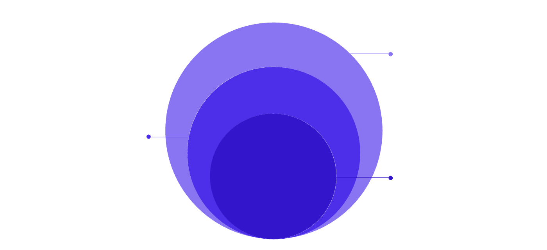
Multi-Hop Neighborhood Discovery
2+ HOP Network
Indirect peers and paths to known entries.
1-HOP Counterparties
Direct transaction peers
Unknown Wallet
Central node under investigation
Relevant attribution signals may exist several transactions away from the original wallet. The graph service performs neighborhood discovery and traversal to expose these relationships.
Hop-based traversal
Connected components / neighborhoods
Transaction paths
Counterparty relationships
Proximity to known entities
Relevant graph evidence
Graph traversal converts an unstructured transaction history into an analyzable relationship network.

Slide 7
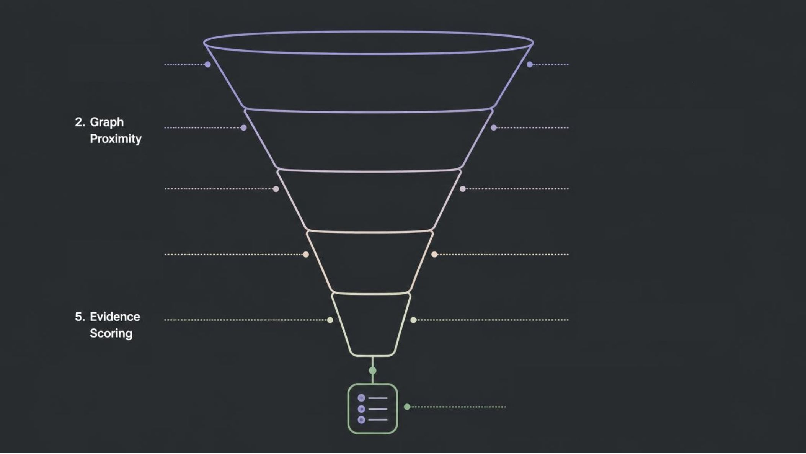
The Crux: Progressive Candidate Filtering
1. Transaction Relevance
Unknown, large blockchain search space
Filter addresses by proximity to target entity/entities
3. Transaction
Evidence
4. Entity/VASP Intelligence
Score and rank by strength of attribution evidence
The value of the system is not merely finding a VASP — it is systematically filtering the search space to reach the relevant candidates.

Slide 8



From Candidates to Explainable Attribution
Evidence Aggregation Model
CANDIDATE VASP
EVIDENCE SCORE
RANKED CANDIDATES
Receives evidence from:
Combine evidence signals into a attribution score.
Prioritize candidates by accumulated evidence.
Graph Proximity
Transaction Evidence
Entity/VASP Intelligence
Transaction Relationships
The scoring layer combines multiple evidence signals instead of relying on a single address label or transaction.

Slide 9
Explainability: WHO, WHY, HOW
FINAL RESULT ANSWERS:
WHO?
WHY?
HOW?
Candidate VASP
Supporting transaction and graph evidence
Relevant multi-hop path / relationship
Illustrative Example : 3 Candidates
Candidate A: Strong graph relationship + Strong transaction evidence = High accumulated evidence
Candidate B: Moderate graph relationship + Strong transaction evidence = Moderate accumulated evidence
Candidate C: Weak graph relationship + Limited transaction evidence = Lower accumulated evidence
This makes the attribution process transparent and auditable.

Slide 10
System Output: Investigative Intelligence Platform
TARGET WALLET
CANDIDATE VASPS
TRANSACTION / GRAPH PATH
0xAbCdEf123...
Visual representation of transaction relationships and relevant multi-hop connections.
Exchange X
Wallet Service Y
Brokerage Z
Wallet submitted for attribution analysis.
RANKED ATTRIBUTION
Candidate VASP A — Strong supporting evidence
Candidate VASP B — Moderate supporting evidence
SUPPORTING EVIDENCE
Transaction IDs / hashes
Transaction relationships
Graph paths / hop relationships
Known VASP / entity information
Candidates are ranked using accumulated graph, transaction, and entity evidence.

Slide 11








Demo Flow: User Journey
2. SELECT BLOCKCHAIN / ANALYSIS PARAMETERS
1. ENTER WALLET ADDRESS
3. COLLECT BLOCKCHAIN INTELLIGENCE
8. DISPLAY ATTRIBUTION
7. AGGREGATE EVIDENCE + SCORE
4. BUILD TRANSACTION GRAPH
6. GENERATE VASP CANDIDATES
5. TRAVERSE RELEVANT MULTI-HOP NEIGHBORHOOD

Slide 12







Complete Attribution Pipeline
UNKNOWN WALLET
BLOCKCHAIN INTELLIGENCE
TRANSACTION GRAPH
MULTI-HOP NEIGHBORHOOD DISCOVERY
PROGRESSIVE CANDIDATE FILTERING
EVIDENCE SCORING
VASP ATTRIBUTION

Slide 13
Why This Matters: System Impact
1
2
3
AUTOMATED
GRAPH-DRIVEN
EXPLAINABLE
Reduces manual effort in tracing complex blockchain transaction networks.
Uses transaction relationships and multi-hop connectivity instead of relying only on direct address labels.
Produces attribution supported by graph paths, transaction relationships, and accumulated evidence.

